Slide 1
Kolla Mission To provide production-ready containers and deployment tools for operating OpenStack clouds.

Slide 2











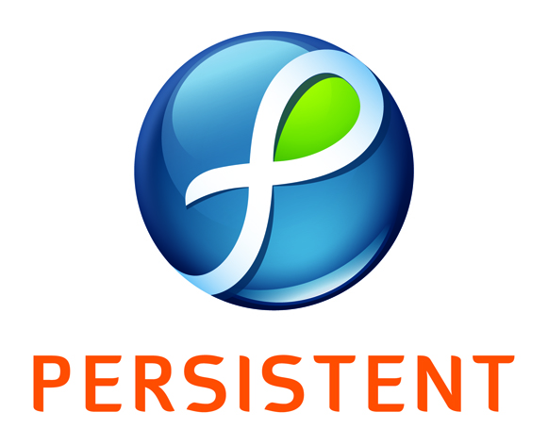

Diverse Corporate Contributors
2

Slide 3
Liberty Midcycle compared to Mitaka Midcycle Stats Numbers on left are from 7/27/2015 Numbers on right are from 2/8/2016 Both measure only the midcycle
1465->2740
293->615
29096->37928
patch sets
commits
lines of code
3
L MC: 2015-07-27
M MC: 2016-02-08
28->58
17->28
months
engineers
affiliations
measured
60->125 people have interacted

Slide 4
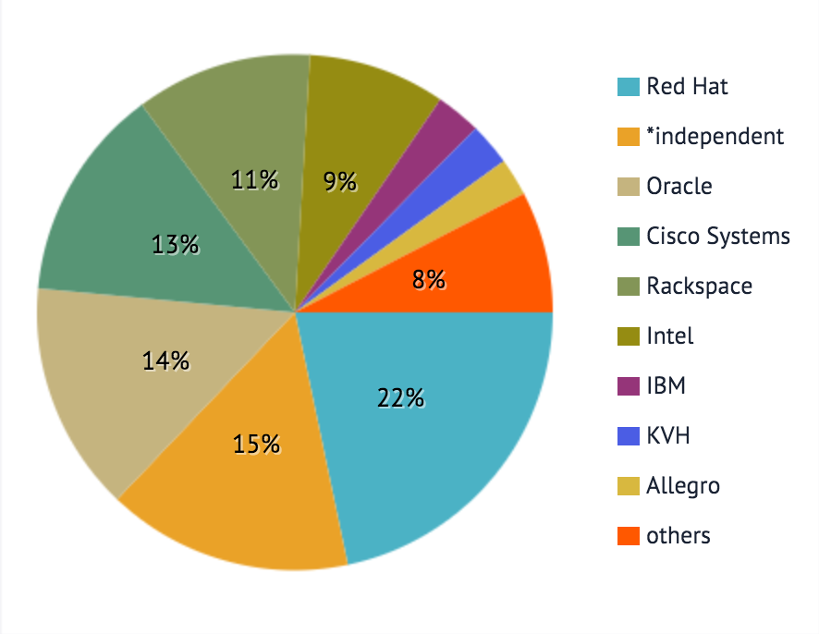
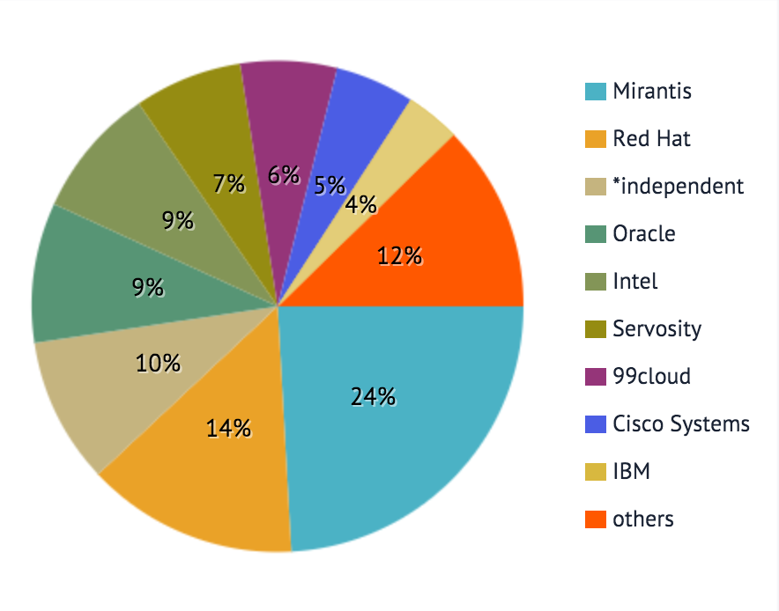
Person Day Effort – growing Community involvement
Full Liberty
Mitaka Midcycle
116 ICs for 6 months
125 ICs for 3 months

Slide 5
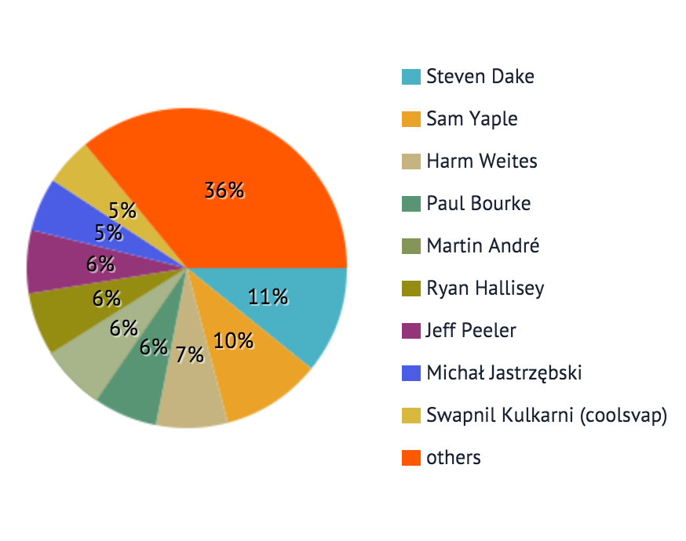
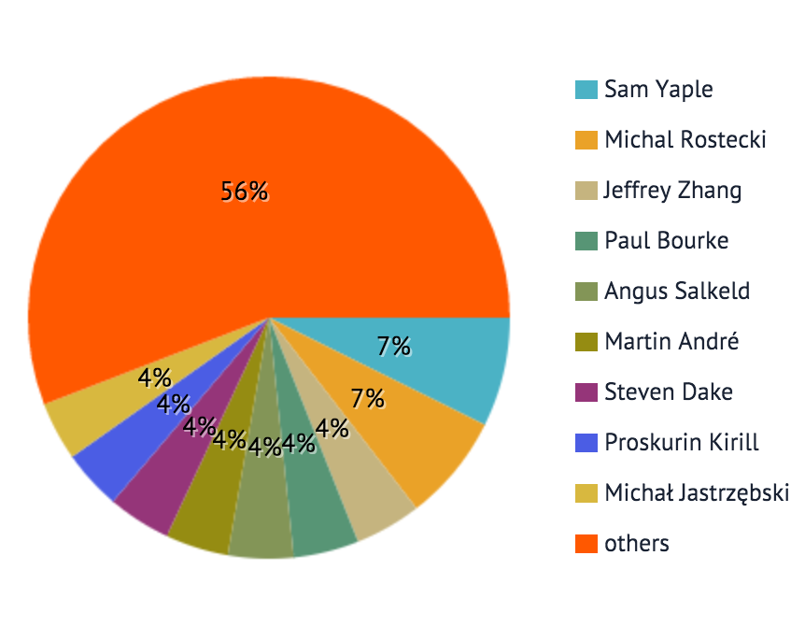
Person Day Effort – Individual diversity on the rise!
Full Liberty
Mitaka Midcycle
Top 9 contributors changed from 64% to 44% as measured by PDE

Slide 6
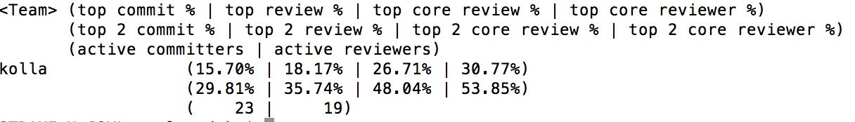
Governance repository teamstats.py
6 month stats
23 active committers (minimum 6 commits in 6 months)
19 active reviewers (minimum 30 reviews in 6 months)

Slide 7
Kolla Differentiators
Container image based deployments
Simple repeatable upgrade process
Works out of box with complete customizability
Usable for novice and power users
Uses Docker and Ansible
Using strongly emergent dependencies
Community Best Practices
Software uses best of breed practices

Slide 8
Mitaka Top Three Priorities
Upgrades, Upgrades, Upgrades
Security, Security, Security
Diagnostics, Diagnostics, Diagnostics

